Slide 1
Computer Networks
Transmission Media
S.V.Jansi Rani
Associate Professor / CSE
Notes:
The University of Adelaide, School of Computer Science
Chapter 2 — Instructions: Language of the Computer

Slide 2
Agenda
Guided Media
Twisted Pair Cable
  Coaxial Cable
  Fiber Optic Cable
Unguided Media
  Radio Waves
  Microwaves
  Infrared
Notes:
The University of Adelaide, School of Computer Science
Chapter 2 — Instructions: Language of the Computer

Slide 3



Slide 4
Transmission Medium
Transmission medium can be broadly defined as anything that can carry information from a source to a destination
Eg: Free space, metallic cable or fiber-optic cable

Slide 5

Transmission medium and physical layer

Slide 6

Classes of transmission media

Slide 7
7-1 GUIDED MEDIA
Guided media, which are those that provide a conduit from one device to another, include twisted-pair cable, coaxial cable, and fiber-optic cable.
Topics discussed in this section:
Twisted-Pair Cable
Coaxial Cable
Fiber-Optic Cable

Slide 8

Twisted-pair cable
One -carry signals , other -ground reference.
Receiver uses the difference between the two.
Interference (noise) and crosstalk -affect both wires and create unwanted signals.
By twisting the pairs, a balance is maintained

Slide 9

UTP and STP cables
STP cable has a metal foil or braided mesh covering that encases each pair of insulated conductors
Prevents but bulkier and expensive

Slide 10
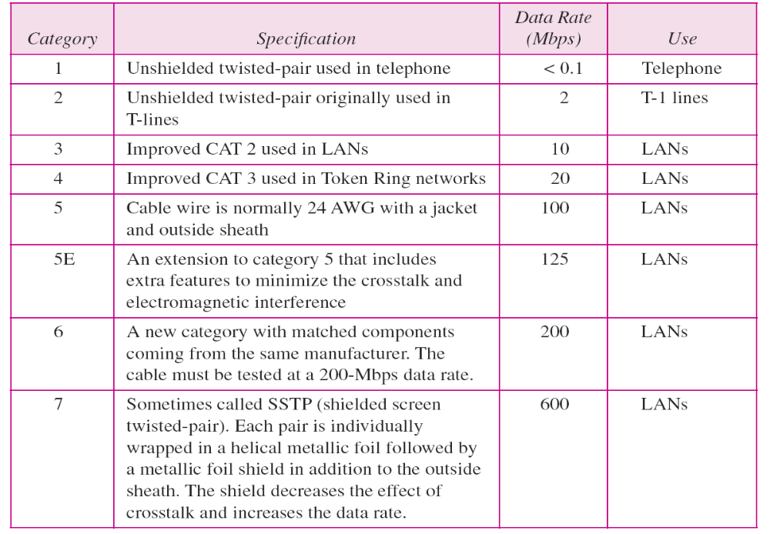
Categories of unshielded twisted-pair cables

Slide 11

UTP connector
The RJ45 is a keyed connector, meaning the connector can be inserted in only one way.
Performance -compare attenuation versus frequency and distance.
Attenuation, - decibels per kilometer (dB/km), sharply increases with frequencies above 100 kHz.

Slide 12

UTP performance

Slide 13

Coaxial cable

Slide 14

Categories of coaxial cables

Slide 15

BNC connectors

Slide 16

Coaxial cable performance

Slide 17

Fiber optics: Bending of light ray
A fiber-optic cable is made of glass or plastic and transmits signals in the form of light.

Slide 18

Optical fiber

Slide 19

Propagation modes

Slide 20

Modes
Multimode graded-index fiber, decreases this distortion
of the signal through the cable, density varies
Multimode step-index fiber, the density -remains constant , beam of light - straight
Line
Single-mode -
beams to a small range of angles (=90), all close to the horizontal , less density core

Slide 21

Fiber types

Slide 22

Fiber construction

Slide 23

Fiber-optic cable connectors
Cable TV
Networking devices

Slide 24

Optical fiber performance

Slide 25
Advantages
Higher bandwidth
Less signal attenuation
Immunity to electromagnetic interference
Resistance to corrosive materials
Light weight
Greater immunity to tapping

Slide 26
Disadvantages
Installation and Maintenance
Unidirectional light propagation
Cost

Slide 27
7-2 UNGUIDED MEDIA: WIRELESS
Unguided media transport electromagnetic waves without using a physical conductor. This type of communication is often referred to as wireless communication.
Topics discussed in this section:
Radio Waves
Microwaves
Infrared

Slide 28

Electromagnetic spectrum for wireless communication

Slide 29

Propagation methods

Slide 30

Bands

Slide 31

Wireless transmission waves

Slide 32
Radio waves are used for multicast communications, such as radio and television, and paging systems. They can penetrate through walls.
Highly regulated. Use omni directional antennas

Slide 33

Omnidirectional antenna

Slide 34

Note
Microwaves are used for unicast communication such as cellular telephones, satellite networks,
and wireless LANs.
Higher frequency ranges cannot penetrate walls.
Use directional antennas - point to point line of sight communications.

Slide 35

Unidirectional antennas

Slide 36
Infrared Waves
Frequency - 300GHz to 400 THz, Wavelength from 1nm to 770 nm
high frequency, cannot peneterate through walls
Cannot use infrared waves outside a building because the sun’s rays contain infrared waves that can interfere with the communication.
suitable for short range communications eg: remote control

Slide 37
Applications
keyboards, mice, PCs, and printers
IrDA port that allows a wireless keyboard to commnicate with a PC.
Standard data rate DR -75 kbps for a distance up to 8 m.
Recent DR -4 Mbps.

Slide 38
Infrared signals can be used for short-range communication in a closed area using line-of-sight propagation.

Slide 39
Wireless Channels
Are subject to a lot more errors than guided media channels.
Interference is one cause for errors, can be circumvented with high SNR.
The higher the SNR the less capacity is available for transmission due to the broadcast nature of the channel.
Channel also subject to fading and no coverage holes.

Slide 40
THANK YOU

